Slide 1

Presentation on TechifyIndia
NIKHEEL THAKKA 393CS2

Slide 2
Overview of the Organization:
TechifyIndia is a start-up for providing IT solutions, building innovative IoT products providing systems integration solutions and technology provider
Since 2017, the company have been providing service like:(website development, design services, IoT, application development and technical support) to clients in various industries
Our creative team brings business to the next level of digitalization with mobile apps and internet marketing to improve branding and lead generation to succeed.

Slide 3

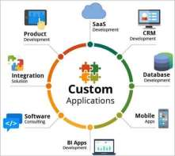



What Techify India do?
Customized-Software’s
Mobile-Applications
Web-Design
AI/ML Projects

Slide 4
Vision and mission of the organization:
Our vision is being one of the most innovative IT Solution and Service provider.
To produce excellent services in the field of IT Services
The company's vision and mission reflect its dedication to creating a positive impact on the industry and society

Slide 5
Organization structure:
The executive team consists of 12 members, with the CEO being the highest-ranking member of the organization.
The organization's structure ensures that each department operates efficiently and effectively while working towards the company's goals.

Slide 6
Roles and Responsibilities of personnel in the organization:
The roles and responsibilities of personnel within the organization vary depending on their job functions and departmental affiliations.
the common roles within the organization include
CEO, Marketing management, Developers, H-R management, etc,

Slide 7
Products and market performance:
TECHIFYINDIA Software Solution’s strength lies in understanding the client’s business processes, culture, vision and goals across the industry segments and offering client oriented solutions which are highly reliable, creating customer comfort. Few of our products are listed below.
Cashew Soft ERP
TAX-E(GST Billing)
CNC Monitoring
IOT Based Smart Bell, etc

Slide 8
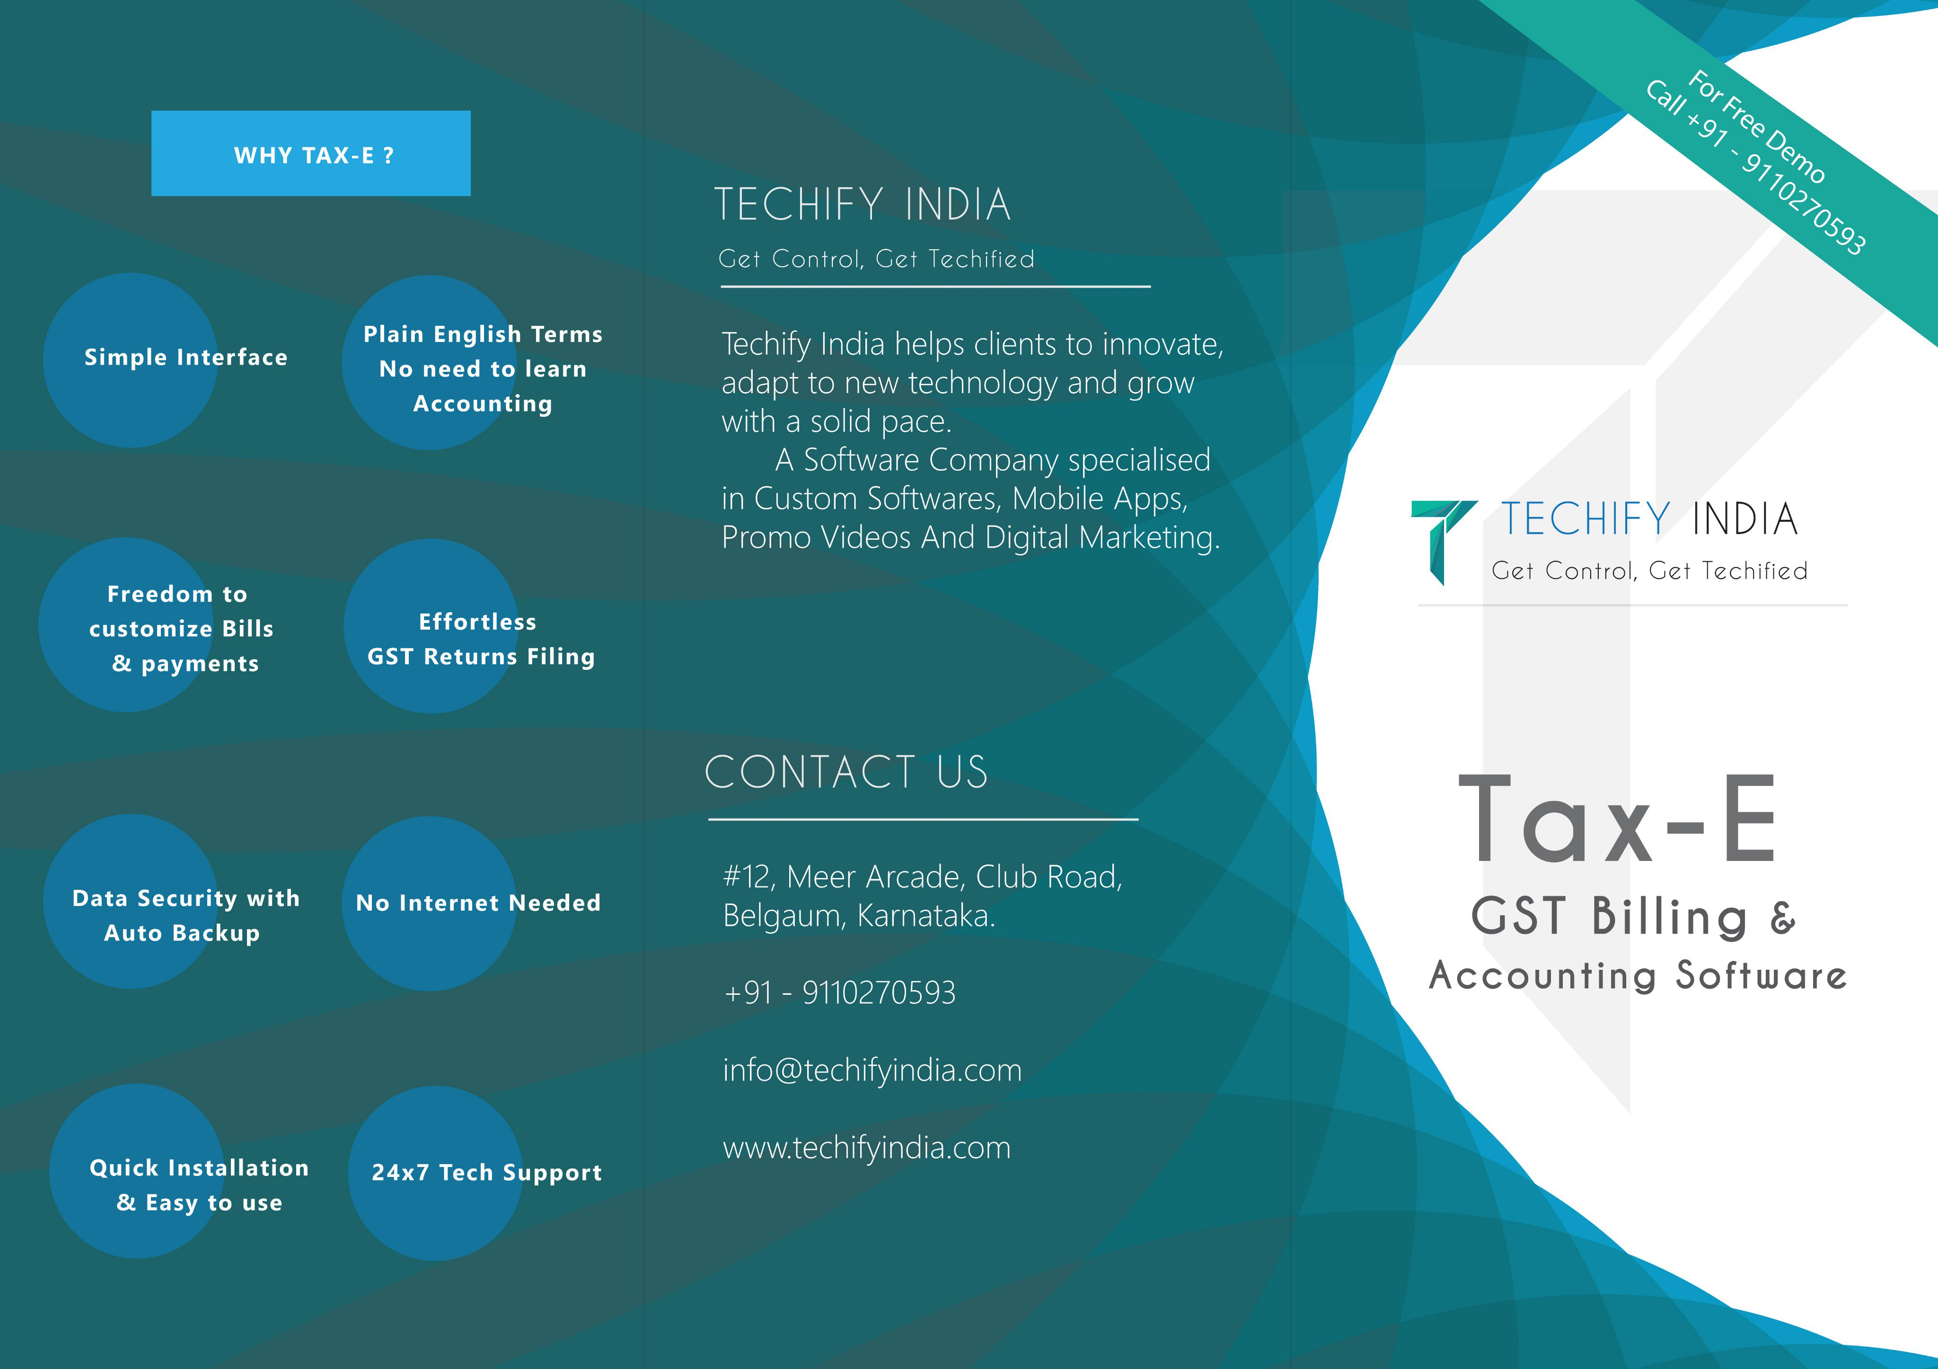


Slide 9





Slide 13
Thank You

